Slide 1

Chapter 12
Systems Design

Slide 2
Objectives
Describe the design phase in terms of your information building blocks.
Identify and differentiate between several systems design strategies.
Describe the design phase tasks in terms of a computer-based solution for an in-house development project.
Describe the design phase in terms of a computer-based solution involving procurement of a commercial systems software solution.
12-<number>

Slide 3
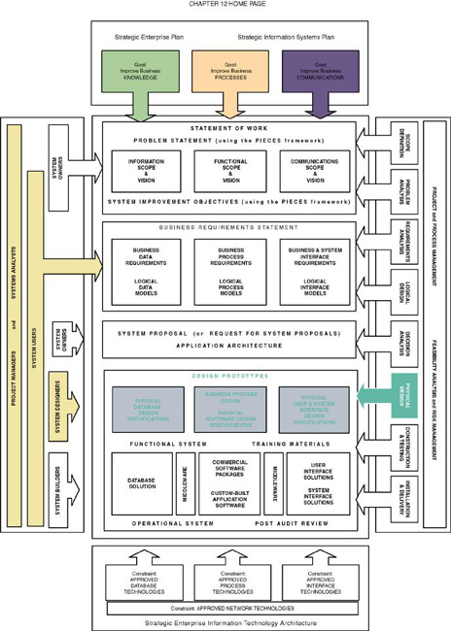
12-<number>

Slide 4
System Design
Systems design – the specification of a detailed computer-based solution.
  Also called physical design.
  systems analysis emphasizes the business problem
  systems design emphasizes the technical or implementation concerns of the system.
12-<number>

Slide 5
System Design Approaches
Model-Driven
  Modern structured design
  Information engineering
  Prototyping
  Object-oriented
RAD
JAD
12-<number>

Slide 6
Model-Driven Approaches
Model-driven strategy – a system design approach that emphasizes drawing system models to document technical and implementation aspects of a system.
12-<number>

Slide 7
Model-Driven Approaches –
Modern Structured Design
Modern structured design – a system design technique that decomposes the system’s processes into manageable components.
  Synonyms (although technically inaccurate) are top-down program design and structured programming.
  Design in a top-down hierarchy of modules
  Easier to implement and maintain (change).
  Modules should be highly cohesive
    Accomplish one function only
  Modules should be loosely coupled
    Minimally dependent on one another
12-<number>

Slide 8
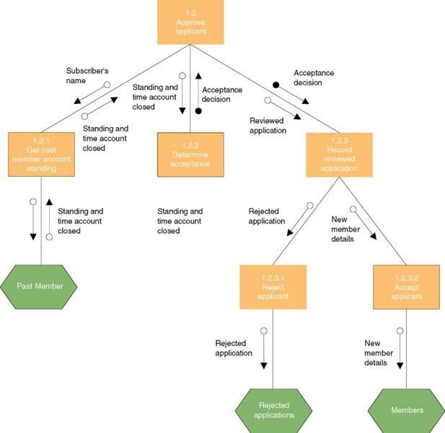
Structure Chart
12-<number>

Slide 9
Model-Driven Approaches – Information Engineering
Information engineering (IE) – a model-driven and data-centered, but process-sensitive technique for planning, analyzing, and designing information systems. IE models are pictures that illustrate and synchronize the system’s data and processes.
  The primary tool of IE is a data model diagram.
12-<number>

Slide 10
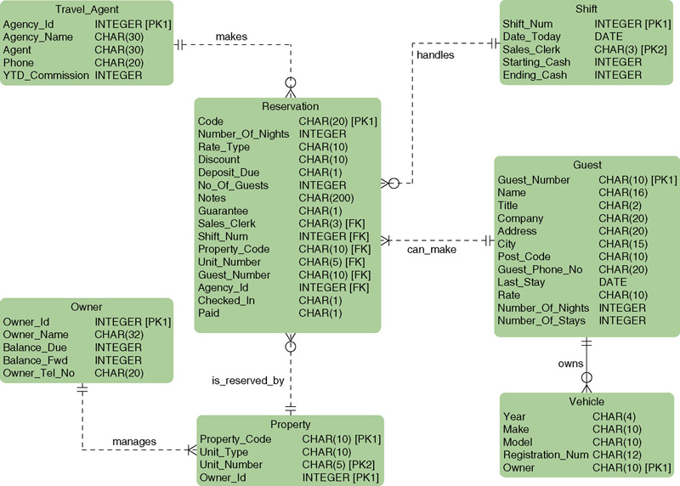
Physical Entity Relationship Diagram
12-<number>

Slide 11
Model-Driven Approaches – Prototyping
Prototype – a small-scale, incomplete, but working sample of a desired system
  Iterative process involving a close working relationship between the designer and the users.
Key Benefits:
  Encourages and requires active end-user participation.
  Iteration accommodates end-users who tend to change their minds.
  Endorses philosophy that end-users won’t know what they want until they see it.
  Active model that end-users can interact with.
  Errors can be detected earlier.
  Can increase creativity as it allows for quicker user feedback.
  Accelerates several phases of the life cycle.
12-<number>

Slide 12
Model-Driven Approaches – Prototyping
Disadvantages and Pitfalls:
  Encourages “code, implement, and repair” life cycle that cause maintenance nightmares.
  Still need systems analysis phases, but so easy to skip.
  Cannot completely substitute a prototype for a paper specification (like architect without a blueprint).
  Numerous design issues are not addressed by prototyping.
  Often leads to premature commitment to a design.
  Scope and complexity of the system can expand out of control.
  Can reduce creativity in designs .
  Often suffer from slower performance because of language considerations (rapidly becoming a non-issue).
12-<number>

Slide 13
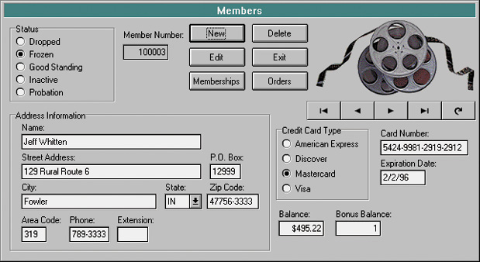
Prototype screen
12-<number>

Slide 14
Model-Driven Approaches –
Object-Oriented Design
Object-oriented design (OOD) techniques are used to refine the object requirements definitions identified earlier during analysis, and to define design specific objects.
  Extension of object-oriented analysis
  Attempt to eliminate the separation of concerns about data and process.
12-<number>

Slide 15
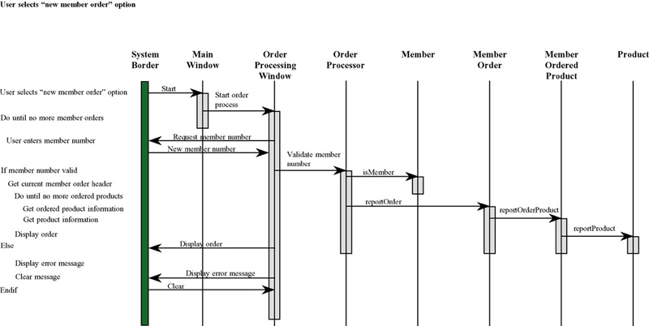
Object-Oriented Design Model
12-<number>

Slide 16
Rapid Application Development (RAD)
Rapid application development (RAD) – a systems design approach that utilizes structured, prototyping, and JAD techniques to quickly develop systems.
  The merger of various structured techniques to accelerate systems development
    Data-driven information engineering
    Prototyping
    Joint application development
12-<number>

Slide 17
Joint Application Development (JAD)
Joint Application Development (JAD) is a technique that complements other systems analysis and design techniques by emphasizing participative development among system owners, users, designers, and builders.
During the JAD sessions for systems design, the systems designer will take on the role of facilitator for possibly several full-day workshops intended to address different design issues and deliverables.
12-<number>

Slide 18
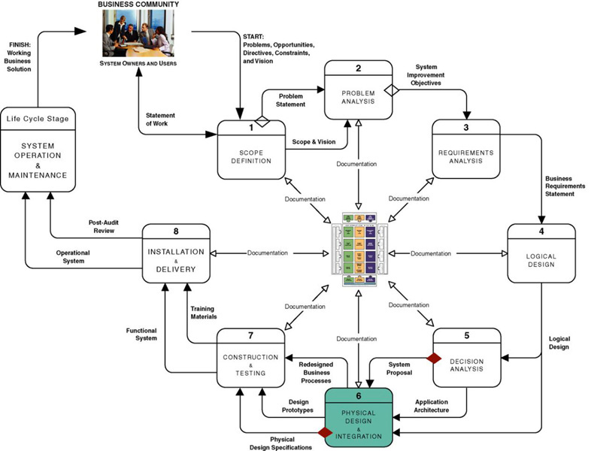
In-House Development
Projects (Build)
12-<number>

Slide 19
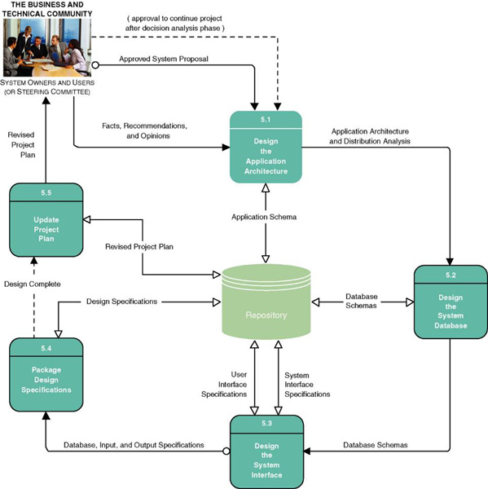
System Design Tasks For
In-House Development
12-<number>

Slide 20
System Design Tasks For In-House Development (Build)
Design the Application Architecture
  Define technologies to be used by (and used to build) one, more, or all information systems.
  Revise models as physical models
Design the System Databases
  Database schema
  Optimized for implementation DBMS
Design the System Interface
  Input, output, and dialogue specifications
  Prototypes
Package Design Specifications
  Specifications to guide programmers
Update Project Plan
12-<number>

Slide 21
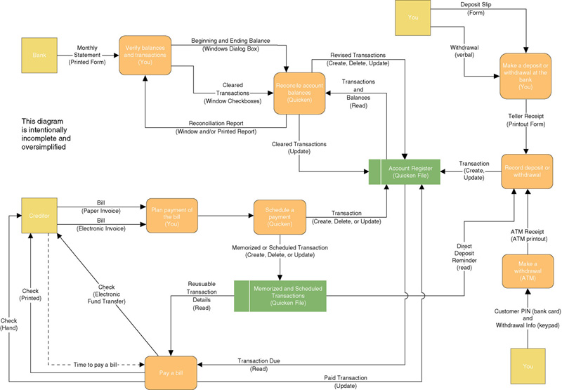
Physical Data Flow Diagram
12-<number>

Slide 22
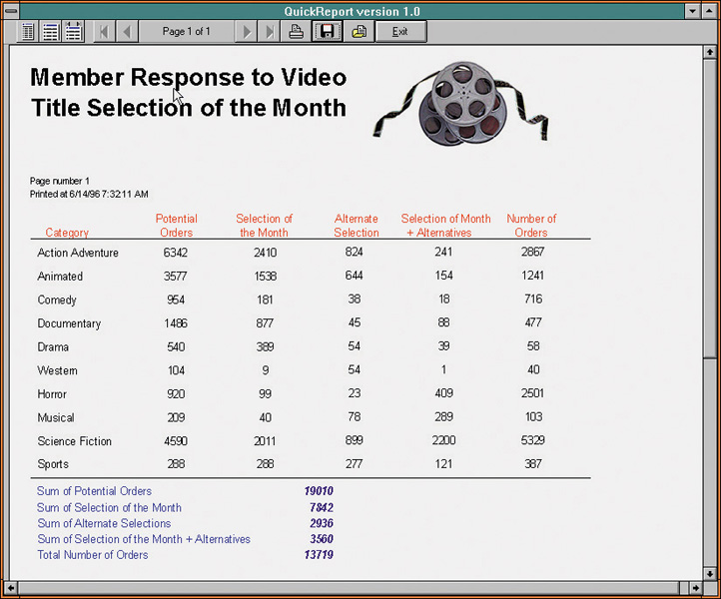
Output Prototype Screen
12-<number>

Slide 23
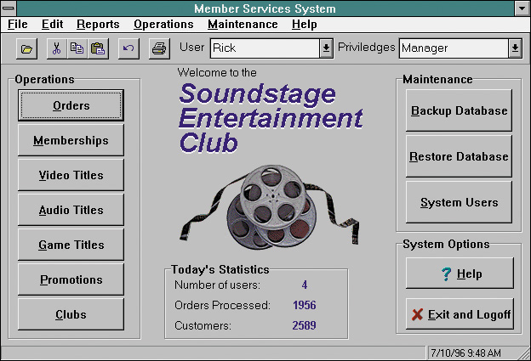
Dialogue Interface Prototype Screen
12-<number>

Slide 24
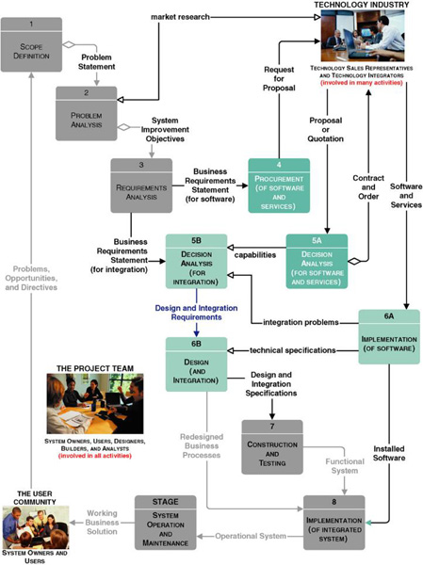
System Design For “Buy” Solutions
12-<number>

Slide 25
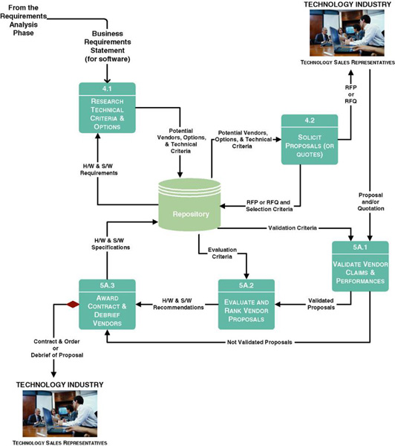
Tasks for Procurement Phase
12-<number>

Slide 26
Tasks for Procurement Phase
Research Technical Criteria and Options
Solicit Proposals or Quotes from Vendors
Validate Vendor Claims and Performances
Evaluate and Rank Vendor Proposals
Award Contract and Debrief Vendors
12-<number>

Slide 27
Research Technical Criteria and Options
Magazines and journals
Internal standards may exist for hardware and software selection.
Information services are primarily intended to constantly survey the marketplace for new products and advise prospective buyers on what specifications to consider.
Trade newspapers and periodicals offer articles and experiences on various types of hardware and software that you may be considering.
12-<number>

Slide 28
Solicit Proposals (or Quotes) From Vendors
Request for Proposals (RFP) – used to communicate requirements and desired features to prospective vendors. Several different vendors and/or products are candidates. They will respond with a proposal.
Request for Quotations (RFQ) – used when you have already decided on a specific product that can be acquired from multiple sources. They respond with a price quotation.
12-<number>

Slide 29
Typical Request For Proposal Outline
Introduction
  Background
  Brief summary of needs
  Explanation of RFP document
  Call for action on part of vendor
Standards and instructions
  Schedule of events leading to contract
  Ground rules that will govern selection decision
    Who may talk with whom and when
    Who pays for what
    Required format for a proposal
    Demonstration expectations
    Contractual expectations
    References expected
    Documentation expectations
12-<number>

Slide 30
Typical Request For Proposal Outline (cont.)
Requirements and features
  Hardware
    Mandatory requirements, features, and criteria
    Essential requirements, features, and criteria
    Desirable requirements, features, and criteria
  Software
    Mandatory requirements, features, and criteria
    Essential requirements, features, and criteria
    Desirable requirements, features, and criteria
  Service
    Mandatory requirements
    Essential requirements
    Desirable requirements
Technical questionnaires
Conclusion
12-<number>

Slide 31
Validate Vendor Claims and Performances
Review vendor proposals and eliminate any that does not meet all mandatory requirements.
Validate the vendor claims and promises against validation criteria.
  User References
  Technical Manuals
  Demonstrations
12-<number>

Slide 32
Evaluate and Rank Vendor Proposals
Feasibility assessment
Scoring system
  Hard-dollar costs – you will have to pay to the selected vendor.
  Soft-dollar costs – additional costs you will incur if you select a particular vendor (to overcome a shortcoming, etc.)
12-<number>

Slide 33
Award Contract and Debrief Vendors
Negotiate contract with selected vendor.
Debrief vendors that submitted losing proposals.
  Not to offer a second chance.
  But to inform them of precise weaknesses in their proposals and/or products.
12-<number>

Slide 34
Impact of Buy Decision on Remaining Life-Cycle Phases
Must integrate or interface the new system to other existing systems.
Decision Analysis
  Make revisions in models to reflect purchased solution.
  Implement purchased solution.
  Integration problems lead to revised business requirements statements.
Design
  Technical specification for a subset of programs to integrate purchased and built solutions.
12-<number>

